Slide 1
PREDICT LOAN APPLICATION STATUS
PROJECT MENTOR :
PROF. ARNAB CHAKRABORTY
Team Members :
Debaleen Das Spandan
Shouvit Pradhan
Amartya Paul
Aditya Som Choudhury
Palash Mondal

Slide 2

CONTENTS
Project Objective & Scope
Data Description
Methodology
Data Preprocessing
Models Used
Accuracy Comparison
Inference
Future Scope of Improvements

Slide 3
PROJECT OBJECTIVE & SCOPE
Objective:
Given : A small loan application dataset taken from Kaggle (contains training and test data).
Goal : To Predict whether a loan application will be accepted based upon applicant data.
Finally : Apply on the test dataset and compare the differences in the results.
Scope :
It is a useful project as the Classifier models can be used to quickly determine the loan approval status of large datasets.
The results might have some mismatch with the real-world applications. But that can be avoided if the models are trained for small datasets.

Slide 4
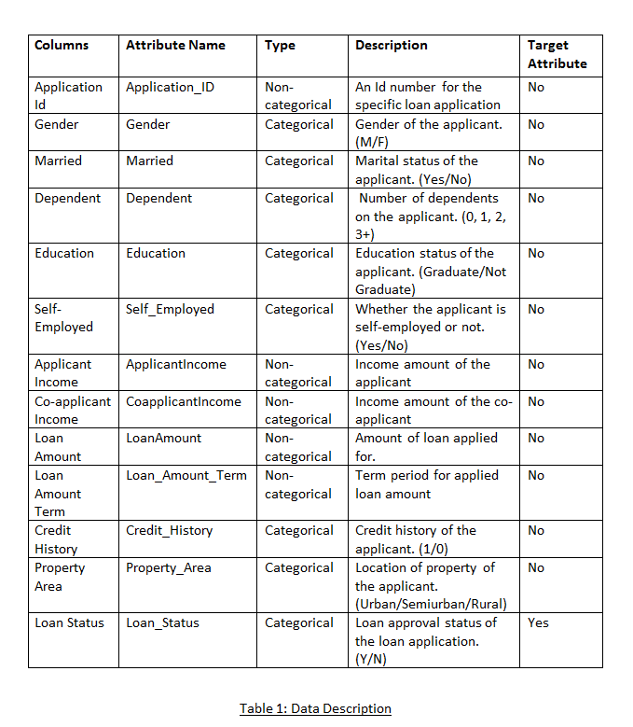
DATA DESCRIPTION
The description of the data with type and description of each Attribute is given/shown in the table.

Slide 5
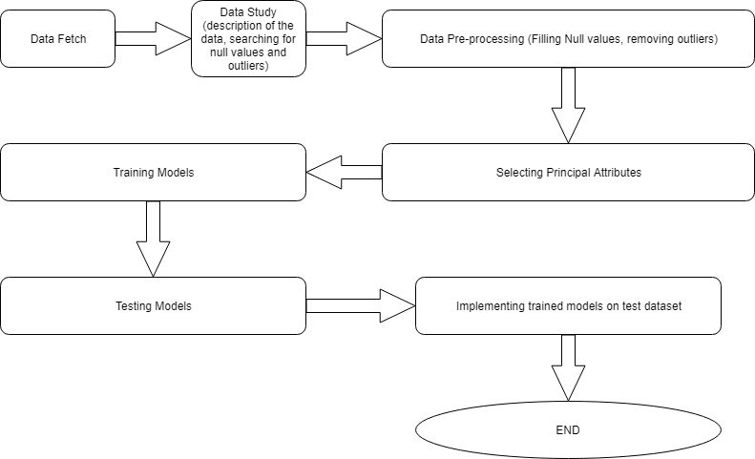
METHODOLOGY

Slide 6
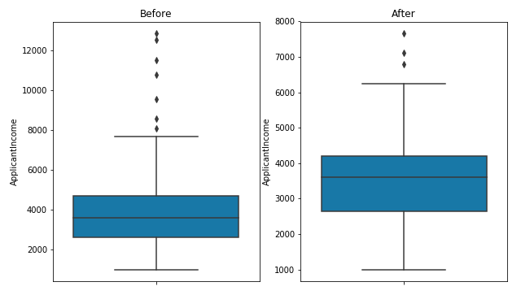
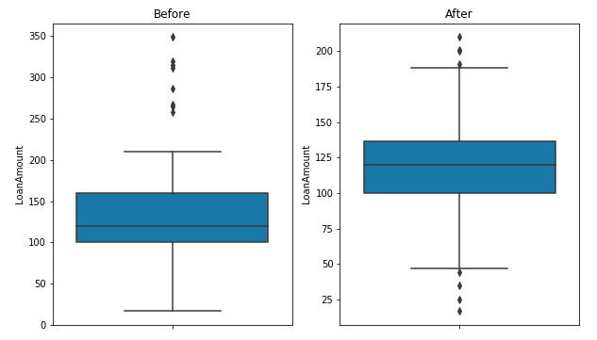
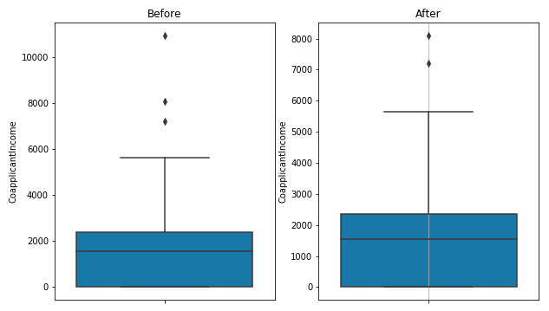
DATA PREPROCESSING
We have changed the categorical values into numeric values.
We handled ouliers using MAD method.

Slide 7

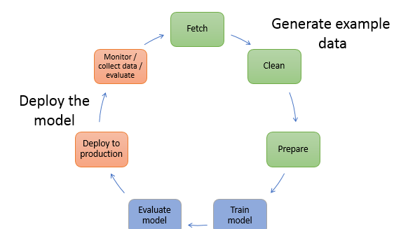
MODELS USED
The Machine Learning models used for this project are:
Naive Bayes ( Gaussian )
K – NN Classification
Regression ( Logistic )
Decision Tree

Slide 8
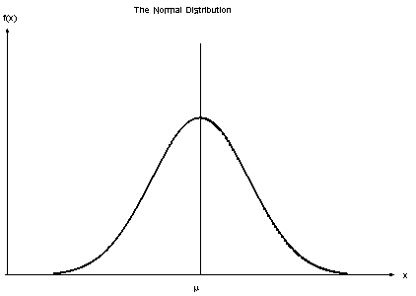
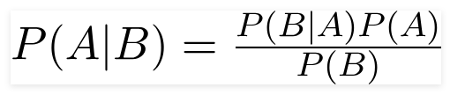
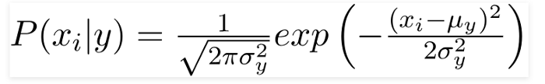
NAIVE BAYES
Principle of Naive Bayes Classifier :
A Naive Bayes classifier is a probabilistic machine learning model that’s used for classification task. The crux of the classifier is based on the Bayes theorem.
Bayes Theorem:
To find the probability of A happening, given that B has occurred.
Gaussian Naive Bayes:
When the predictors take up a continuous value and are not discrete, we assume that these values are sampled from a gaussian distribution.
Since the way the values are present in the dataset changes, the formula for conditional probability changes to,

Slide 9
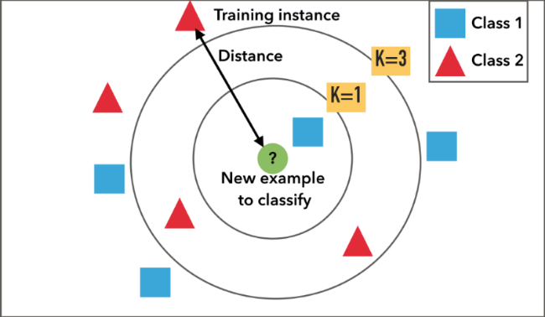
K – NN CLASSIFICATION
A k-nearest-neighbor algorithm, often abbreviated k-nn, is an approach to data classification that estimates how likely a data point is to be a member of one group or the other depending on what group the data points nearest to it are in.
The k-nearest-neighbor is an example of a "lazy learner" algorithm, meaning that it does not build a model using the training set until a query of the data set is performed.

Slide 10
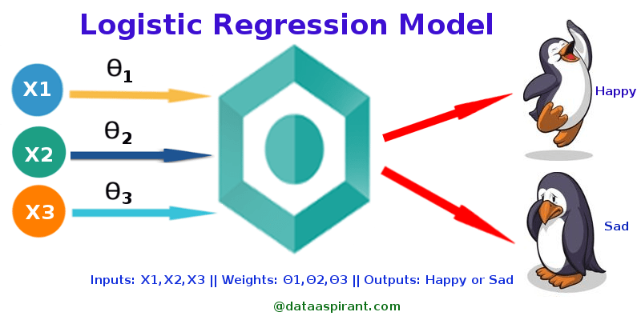
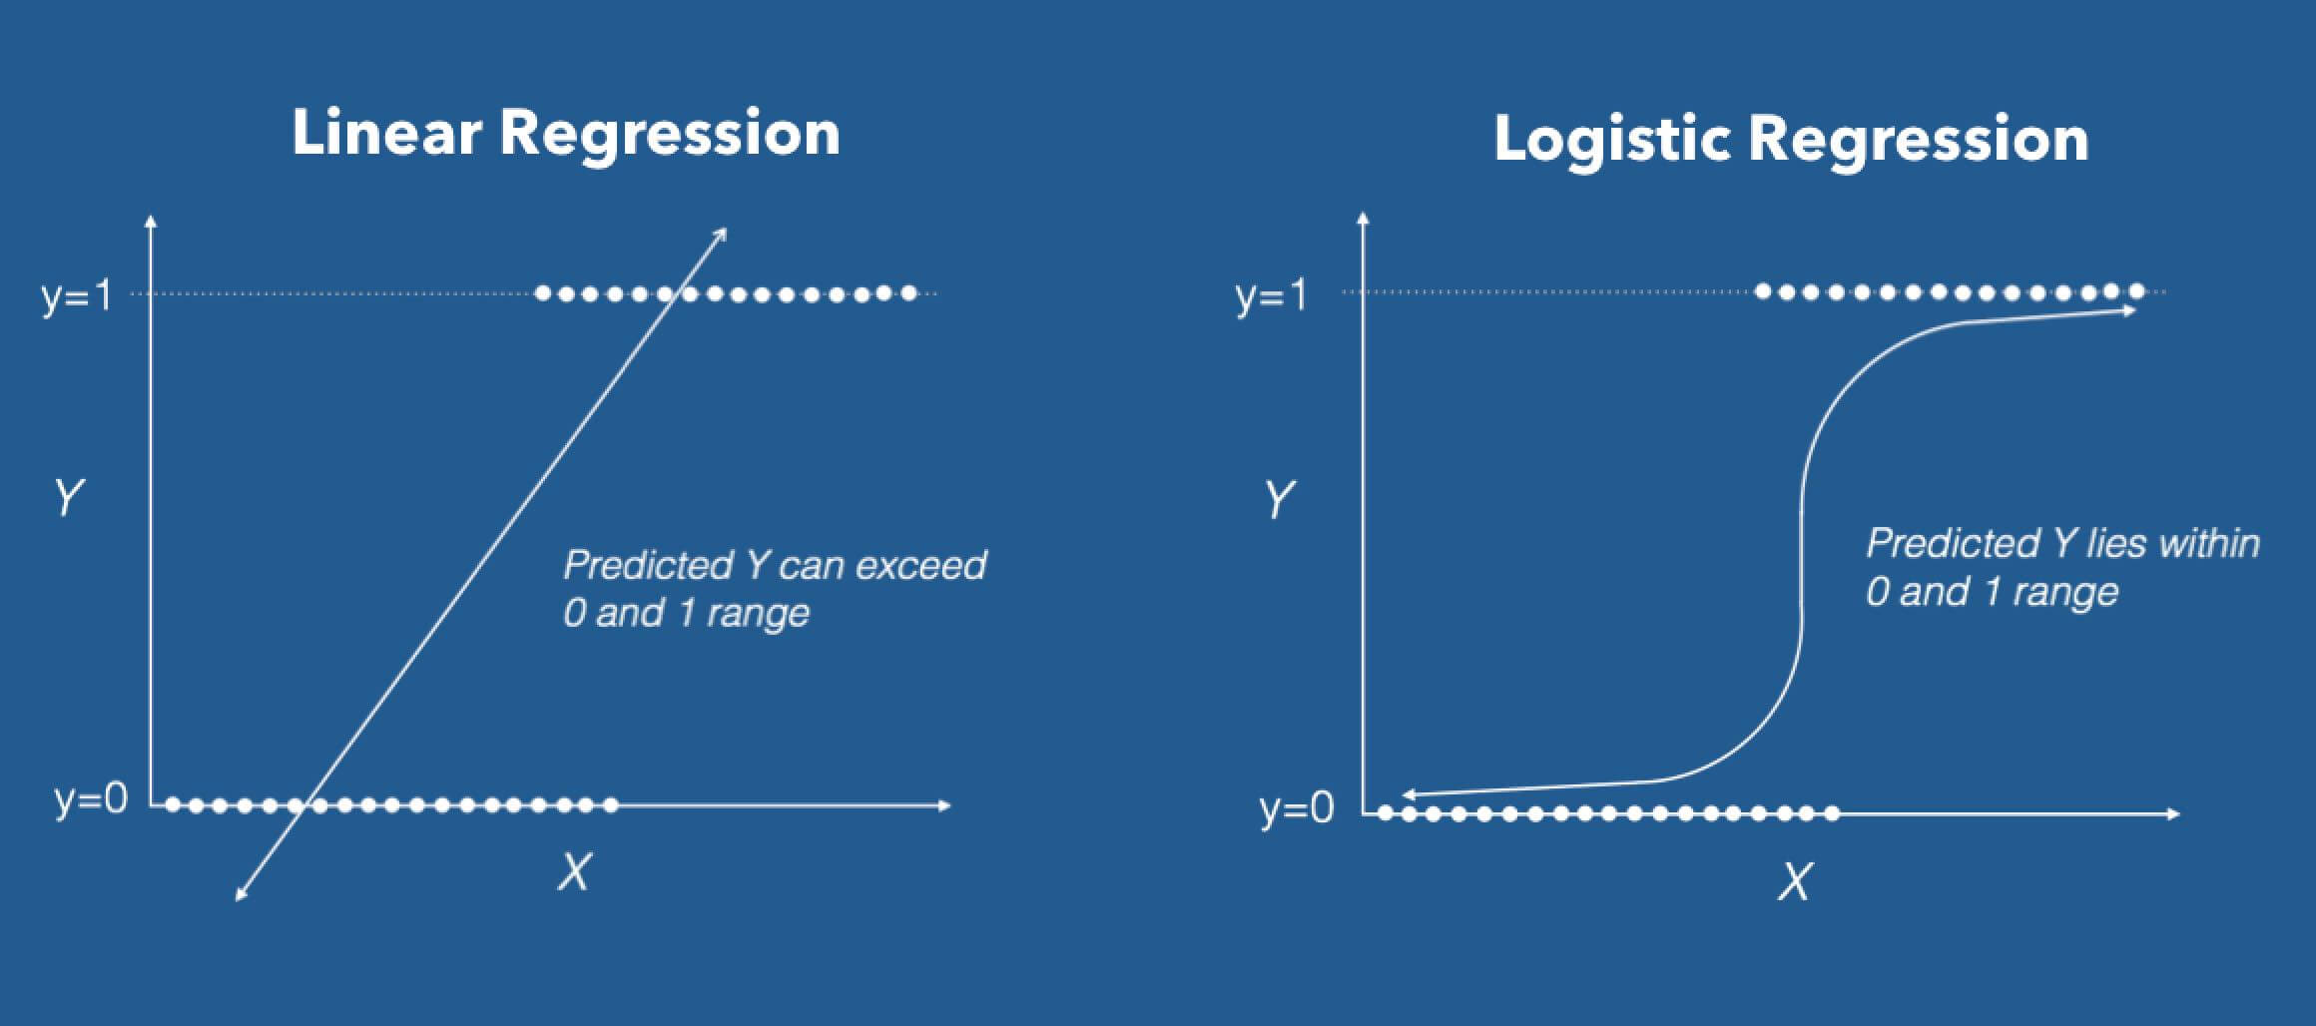
LOGISTIC REGRESSION
Logistic Regression is the appropriate regression analysis to conduct when the dependent variable is dichotomous (binary). Like all regression analyses, the logistic regression is a predictive analysis. Logistic regression is used to describe data and to explain the relationship between one dependent binary variable and one or more nominal, ordinal, interval or ratio level independent variables.

Slide 11
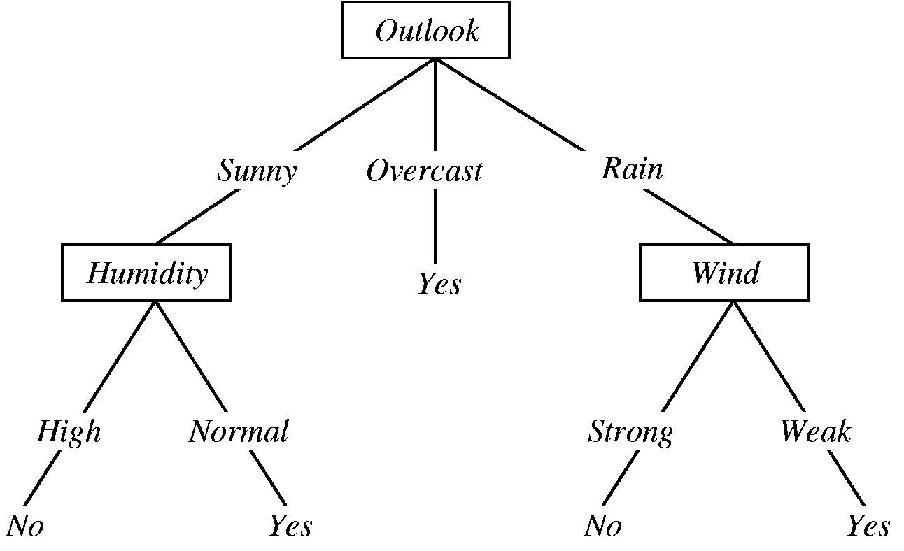
DECISION TREE
A decision tree is a graphical representation of specific decision situations that are used when complex branching occurs in a structured decision process. A decision tree is a predictive model based on a branching series of Boolean tests that use specific facts to make more generalized conclusions.
The main components of a decision tree involve decision points represented by nodes, actions and specific choices from a decision point. Each rule within a decision tree is represented by tracing a series of paths from root to node to the next node and so on until an action is reached.

Slide 12

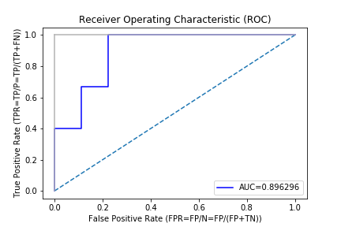
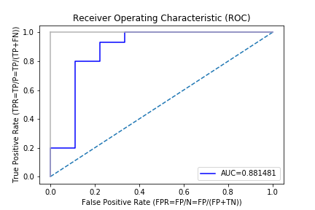
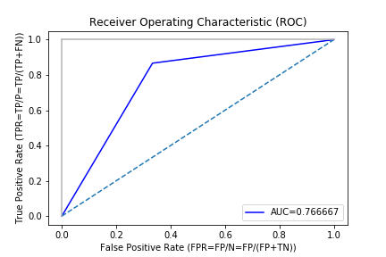
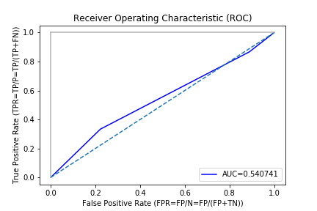
RECEIVER OPERATING CHARACTERISTIC CURVES
Gaussian Naive Bayes
Logistic Regression
Decision Tree
K - NN

Slide 13
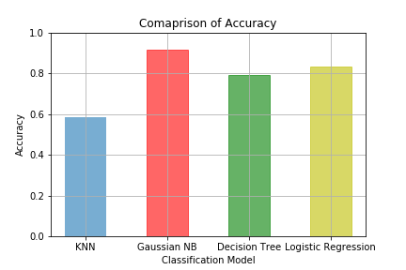
ACCURACY COMPARISON GRAPH
Models Used | Accuracy %
Logistic Regression | 83.334
Gaussian Naive Bayes | 91.667
Decision Tree | 79.167
K – Nearest Neighbor | 58.334
The data shown above is an average of multiple test runs.
We see that the highest accuracy for the train dataset is Gaussian Naive Bayes.
So we select Gaussian Naive Bayes model to predict the test dataset.

Slide 14
INFERENCE
Model Name | 0 ( No ) | 1 ( Yes )
Logistic Regression | 165 | 349
Gaussian Naive Bayes | 247 | 267
Decision Tree | 259 | 255
K – Nearest Neighbor | 142 | 372
The output result of the test dataset obtained by Gaussian Naive Bayes model is inferred to be accepted.

Slide 15
FUTURE SCOPE OF IMPROVEMENTS
Various banking institution can use these models to automate the process of loan approval.
Customers intending to take a loan can use these trained models to check whether their loan application will be approved or not.
Mismatches can be removed like for the attribute "Married" which had high correlation value but low feature importance.
No loan application having value "Rural" in "Property_Area" attribute was approved.

Slide 16
THANK YOU
Bengal College of Engineering & Technology
Debaleen Das Spandan ( ddsmegh4@gmail.com )
Shouvit Pradhan ( shaw7wit@gmail.com )

